Slide 1
Deep Learning in Cancer: Advancing Precision Medicine
MOD002602
Element 010: Component 2
Student ID: *******
Student Name: Dhrumil Shah
Presentation Date: 15/04/2024

Slide 2
Background
Deep Learning is a subset of Machine Learning that involves passing a lot of data through Neural Network, known as Deep Neural Networks, to facilitate automatically learning the inherent pattern within the dataset captured by the model. (Lauzon, 2012)
In medical imaging, the use of deep machine learning for image segmentation, classification, detection, as well as filtering and denoising has seen a significant increase in recent years. (Hatt et al., 2019)
As such, this technology can be a great tool to tackle cancer predictions and treatment. According to a survey conducted in 2020, the number of deaths has increased by around 6% compared to 2001. (Baker & Mansfield, 2023). Use of deep learning models to improve early detection of various cancers can significantly reduce the risk and increase the treatment success rate.

Slide 3
Aim & Objectives
Aim:
To enhance early detection and treatment of various cancers through the application of deep learning in medical imaging.
Objectives:
Acquire diverse datasets including different cancer types, imaging models, and patient demographics to train machine learning models.
Experimentation and optimization of deep learning architectures, such as Convolutional Neural Networks (CNNs) and Recurrent Neural Networks (RNNs), to achieve high accuracy in cancer-related tasks.
Implement ethical guidelines to address concerns related to patient privacy, consent, and biases in machine learning models.
Develop educational resources and training programs to enhance the understanding of machine learning among healthcare professionals and promote the responsible use of these technologies.
Conduct large-scale validation studies in real-world clinical settings to show the practical utility, accuracy, and positive impact of machine learning models on patient outcomes.

Slide 4
Business Case
Market Needs:
Improved Accuracy: Healthcare providers require more accurate and reliable diagnostic tools to improve cancer detection rates and patient outcomes.
Personalized Treatment: There is a growing demand for personalized treatment plans based on individual patient profiles, needing precise diagnostic tools that can tailor therapies to specific cancer types.
Cost-Effective Solutions: Healthcare systems are under pressure to reduce costs while improving quality of care, creating the need for cost-effective diagnostic solutions that offer significant value.
Benefits include higher accuracy, personalized treatment plans, higher efficiency and cost savings.
Cons of using this technology are - need for significantly large initial investment, technical complexity, meeting regulations and guidelines might involve lengthy processes and cost, etc.

Slide 5
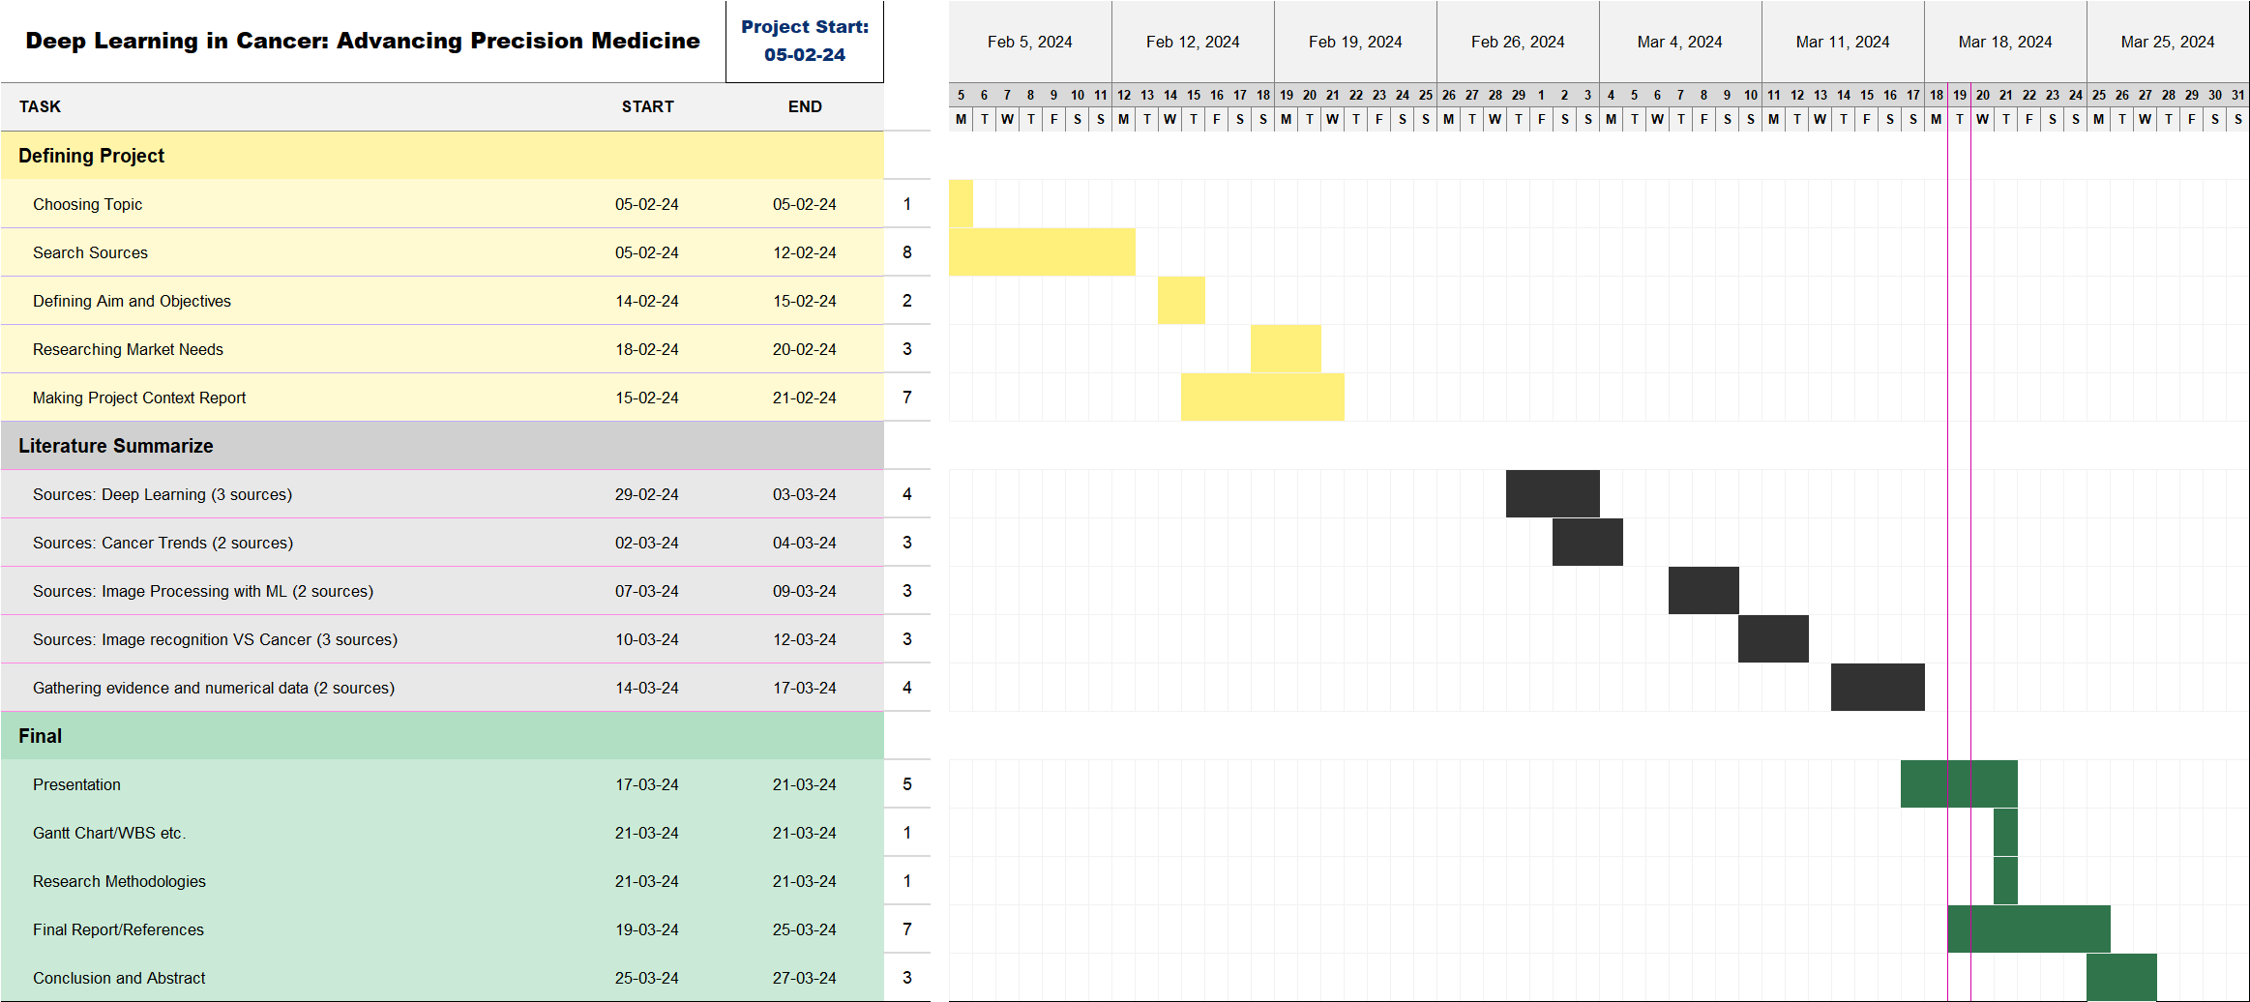
Gantt Chart & WBS
Gantt Chart:

Slide 6
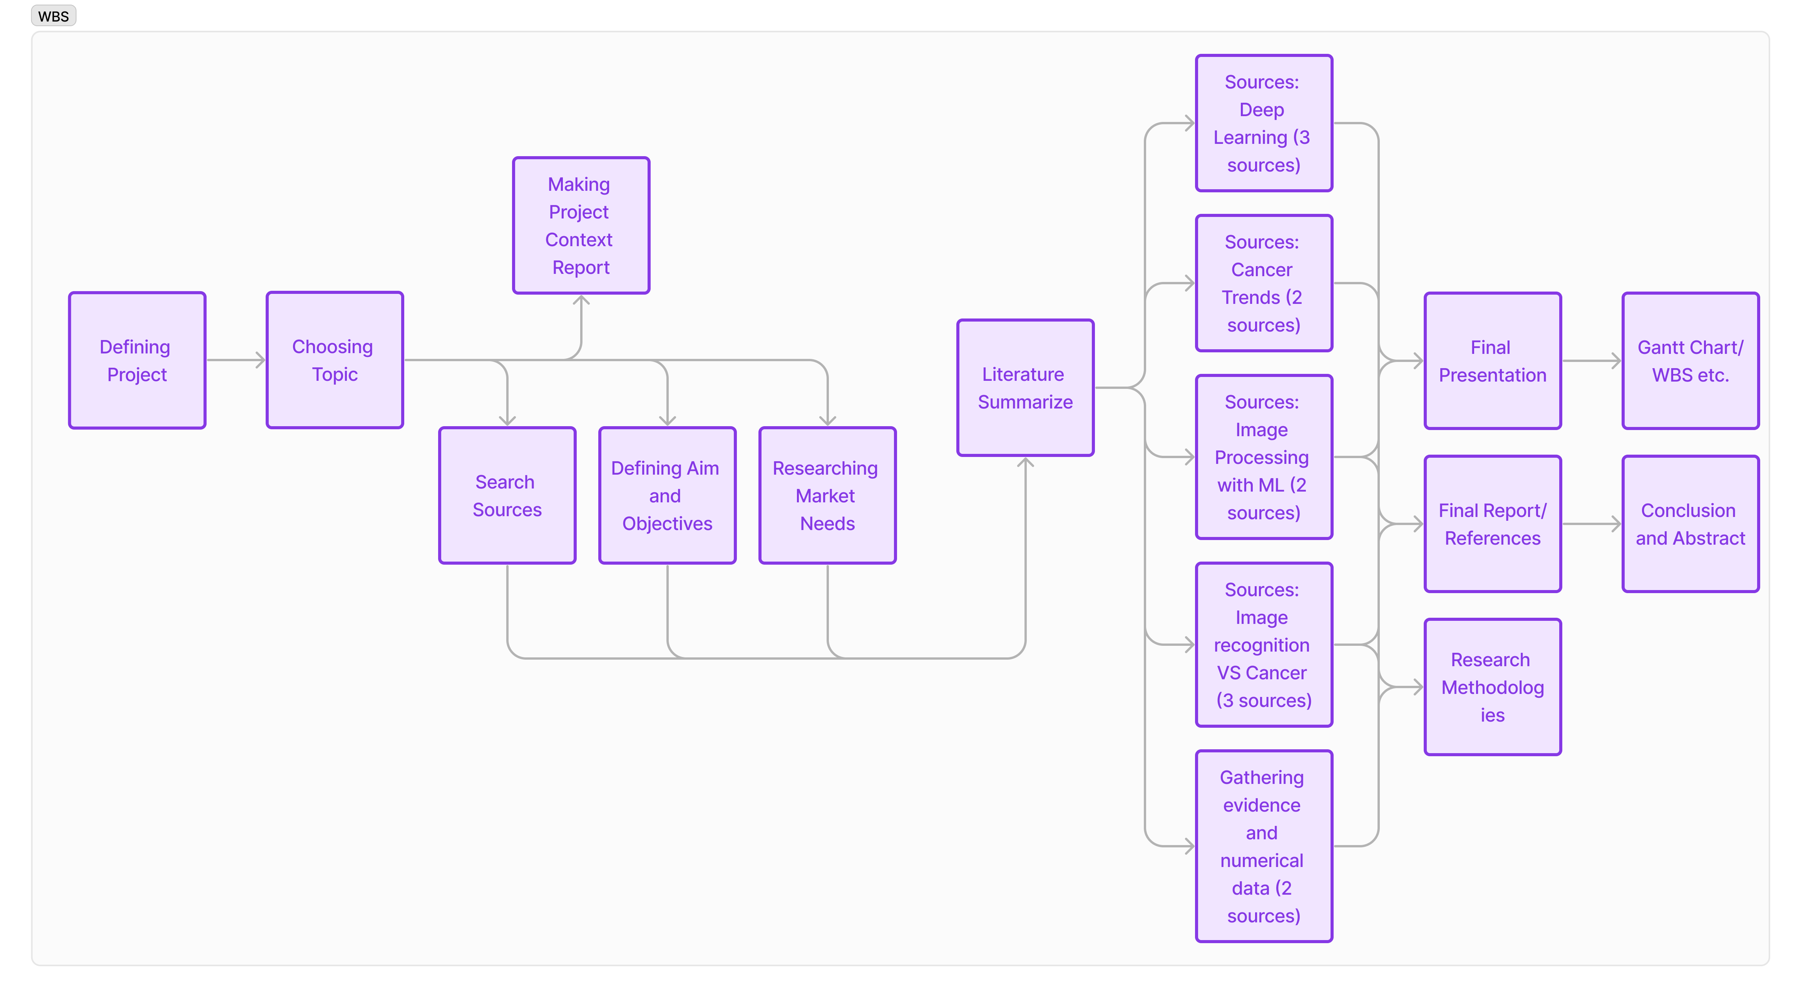
Gantt Chart & WBS
WBS:

Slide 7
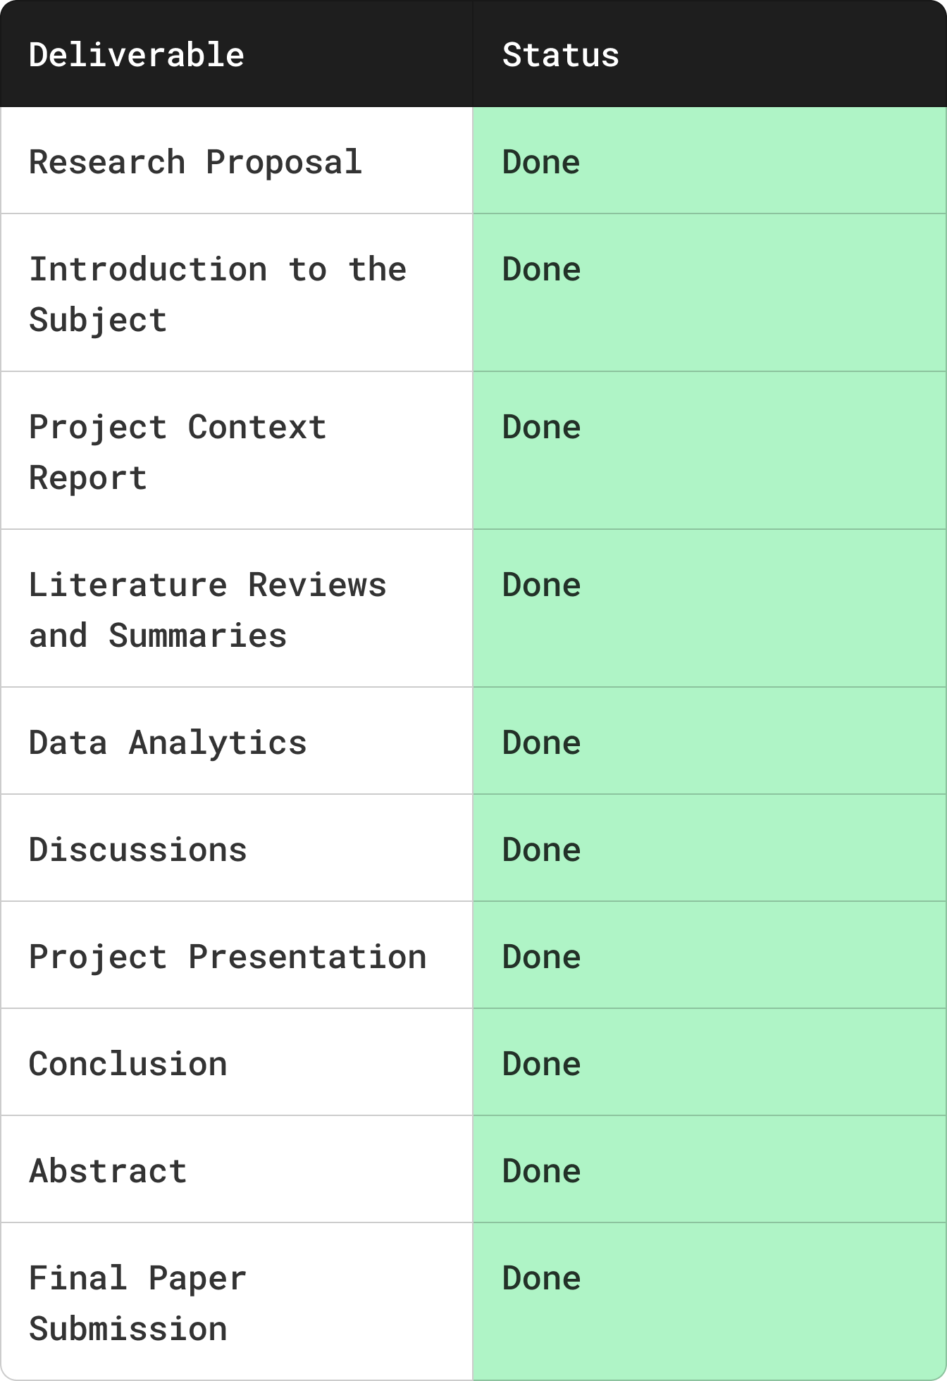
Gantt Chart & WBS
Deliverables:

Slide 8
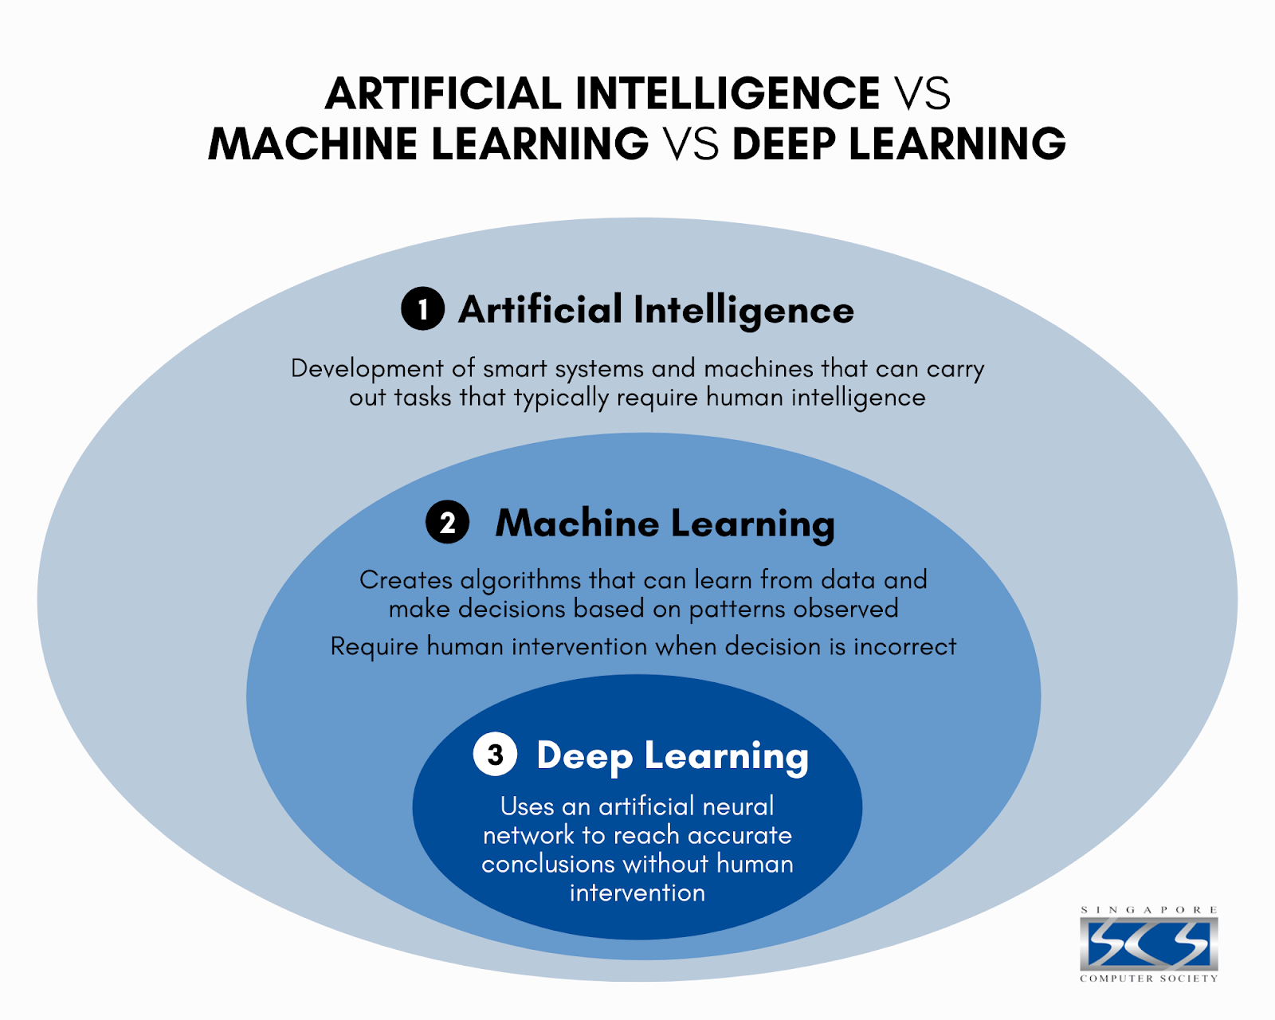
Literature Review: Intro to Deep Learning
(Choi et al., 2020)

Slide 9
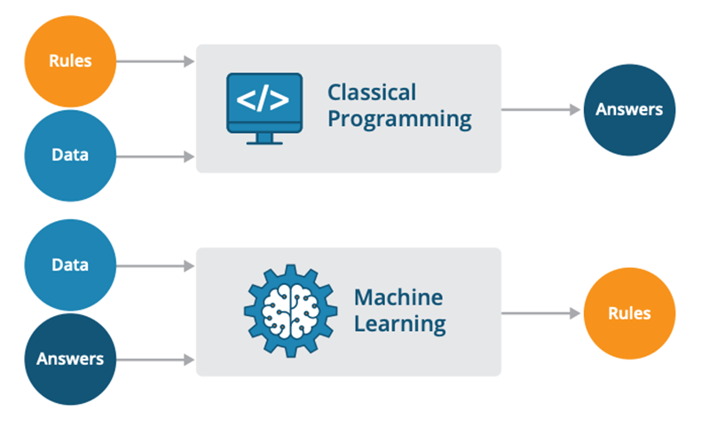
Literature Review: Intro to Deep Learning
(Choi et al., 2020)

Slide 10
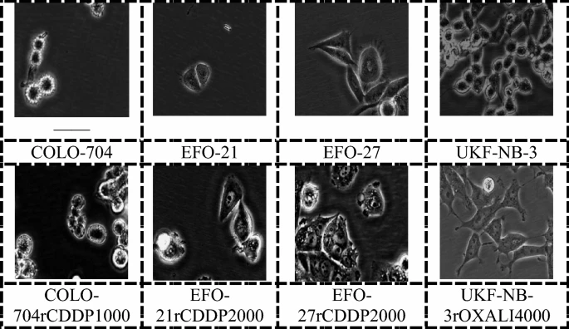
Literature Review: Intro to Deep Learning
There has been a great success in using Machine Learning, or specifically Deep Learning, in recognition as well as differentiation of images.
(Mzurikwao et al., 2020) Figure shows images per cancer cell lines sample processed by application of machine learning systems.

Slide 11
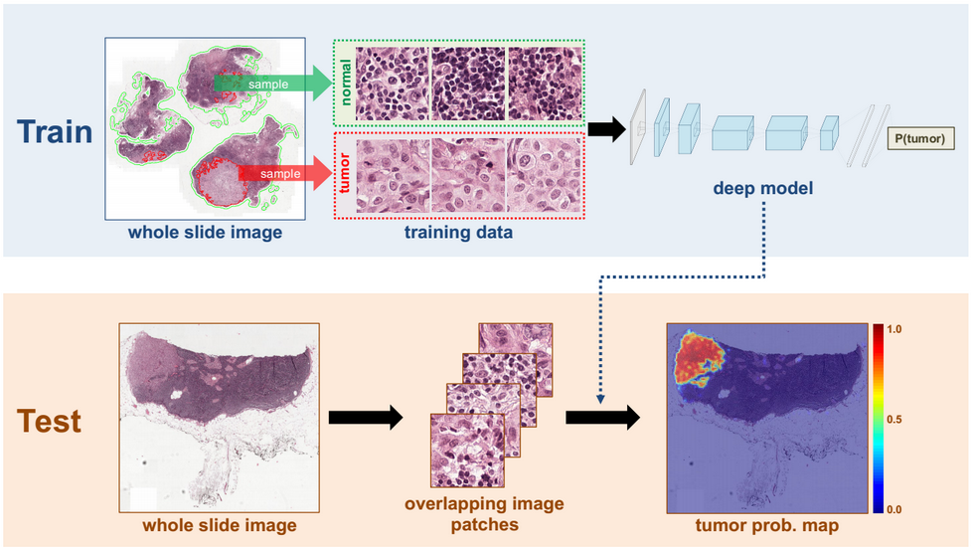
Literature Review: ML-DL in Cancer Prognosis Prediction
The most common type of cancer include breast cancer, prostate cancer, and lung cancer. (National Cancer Institute, 2023). These cancers are easier to diagnose through image recognition, however traditional methods have proven to be unreliable and arduous. But with already available large amounts of cancer diagnosis data has paved a new path in training of Deep learning models specifically designed to predict the risk of cancer. (Daneshjou et al., 2021)
Deep learning is good at sorting images, like spotting skin cancer in photos. It uses complex neural networks, especially convolutional neural networks (CNNs), trained on large datasets covering many categories, to understand image details by mimicking how our brains process visuals. With training on labeled images, the network gets better at recognizing features and refining its layers to classify things more accurately. (Daneshjou et al., 2021)

Slide 12
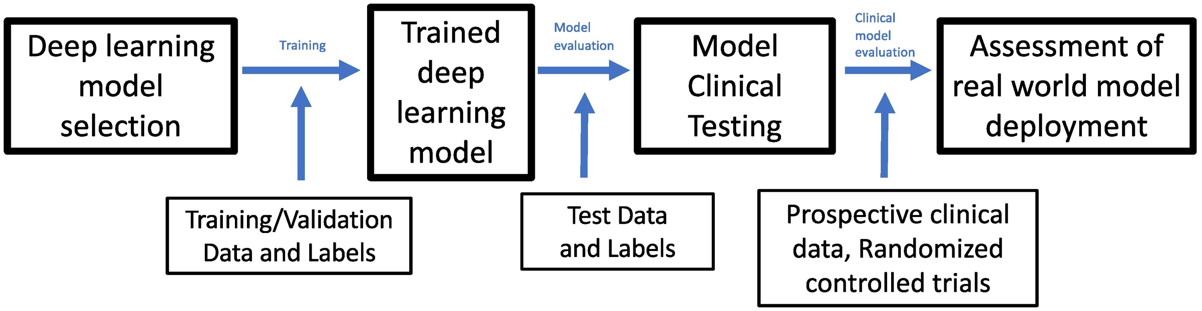
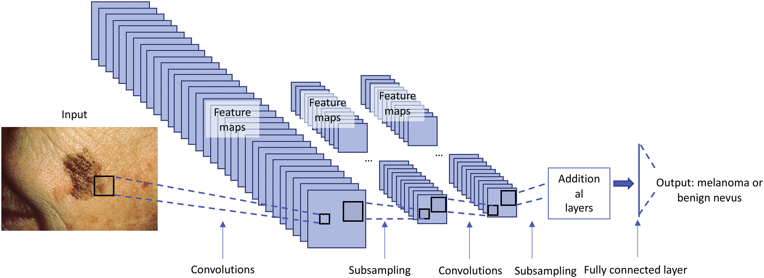
Literature Review: ML-DL in Cancer Prognosis Prediction
During training, labeled images of skin lesions are fed into the neural network. The images undergo processes like feature extraction (convolutions) and simplification (pooling) to help the CNNs grasp image details. As the network learns these details, it adjusts its weights to better classify the images correctly. For instance, in this scenario, it determines whether an image shows a harmless nevus or a melanoma.

Slide 13
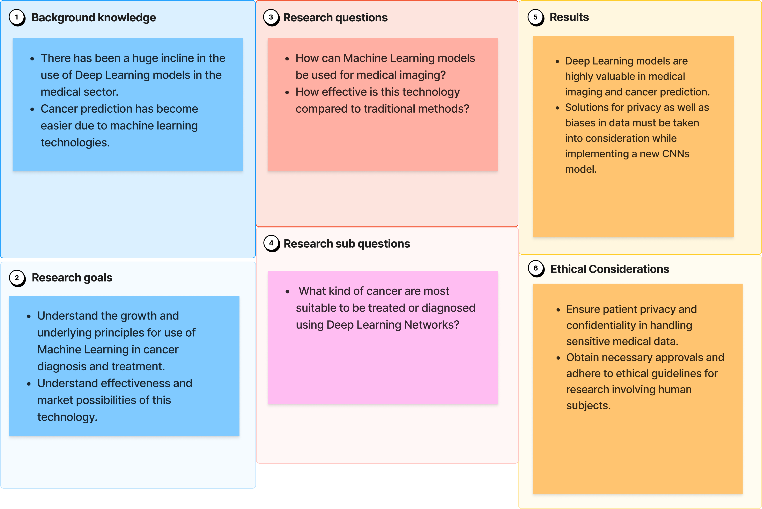
Research Methodologies

Slide 14
Discussion
Deep Learning Networks have proven unparallelly useful in prediction of cancer in early stages through image recognition, however there are still many biased datasets that need to be improved.
Early prediction and personalised treatment plans generated using a large amount of diverse data can help reduce causalities by a huge margin.
Many Deep Learning CNNs have surpassed traditional methods in terms of accuracy, sensitivity, and specificity, however this technology might prove to be costlier for now due to limited growth in the subject.
Deep Learning models are ready to be integrated in the current workflow, however there is still a need for more training and awareness.

Slide 15
Conclusion
Future Research in the field of Deep Learning in Cancer prognosis prediction has a potential to discover areas where further investigation is needed, such as refining the modern Deep Learning architecture, exploring novel data sources, or conducting clinical validation studies on patients.
Deep Learning technology is still a growing subject with unexplored depths, but this rise in the popularity of its use in medical sector, with collaborations and innovations from IBM Watson for Oncology, DeepMind Health, Google Health and many more, will open new opportunities and solutions to the growing dangers of cancer.

Slide 16
References
Lauzon, F. Q. (2012). An introduction to deep learning. In 2012 11th International Conference on Information Science, Signal Processing and their Applications (ISSPA) (pp. 1438-1439). Montreal, QC, Canada. doi: 10.1109/ISSPA.2012.6310529.
Hatt, M., Parmar, C., Qi, J., & El Naqa, I. (2019). Machine (Deep) Learning Methods for Image Processing and Radiomics. IEEE Transactions on Radiation and Plasma Medical Sciences, 3(2), 104-108. doi: 10.1109/TRPMS.2019.2899538.
Baker, C. & Mansfield, Z., 2023. Cancer statistics for England. [Online] Available at: https://commonslibrary.parliament.uk/research-briefings/sn06887/ [Accessed 19 February 2024].
Choi, R. Y., Coyner, A. S., Kalpathy-Cramer, J., Chiang, M. F., and Campbell, J. P. (2020) 'Introduction to machine learning, neural networks, and deep learning', Translational Vision Science & Technology, 9(2), p. 14.
Mzurikwao, D., Khan, M. U., Samuel, O. W., et al. (2020). Towards image-based cancer cell lines authentication using deep neural networks. Scientific Reports, 10, 19857. https://doi.org/10.1038/s41598-020-76670-6
Daneshjou, R., He, B., Ouyang, D., & Zou, J. Y. (2021). How to evaluate deep learning for cancer diagnostics – factors and recommendations. Biochimica et Biophysica Acta. Reviews on Cancer, 1875(2), 188515–188515. https://doi.org/10.1016/j.bbcan.2021.188515.
National Cancer Institute. (2023). Common Cancer Types. Retrieved from https://www.cancer.gov/types/common-cancers

